Slide 1
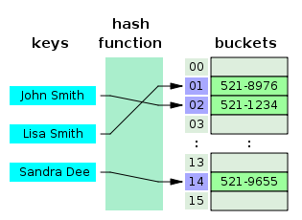
COSC 222 Data Structures
Yves Lucet
CC BY-SA 3.0 https://en.wikipedia.org/wiki/Skip_list#/media/File:Skip_list_add_element-en.gif
"Hash table 3 1 1 0 1 0 0 SP" by Jorge Stolfi - Own work. Licensed under CC BY-SA 3.0 via Commons - https://commons.wikimedia.org/wiki/File:Hash_table_3_1_1_0_1_0_0_SP.svg#/media/File:Hash_table_3_1_1_0_1_0_0_SP.svg
Notes:
11am

Slide 2
inteDashboard
Practice RAT: iRAT + tRAT

Slide 3
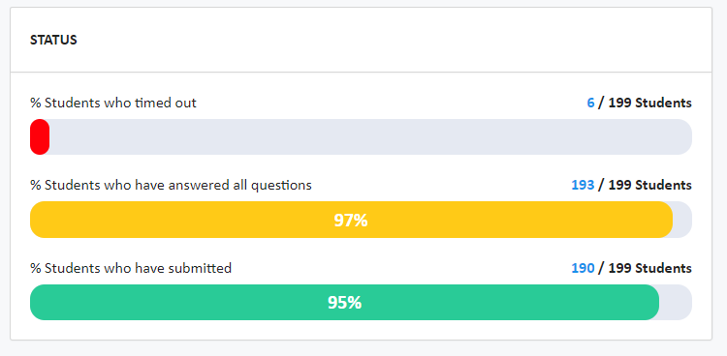
Make sure
You submit your iRAT

Slide 4
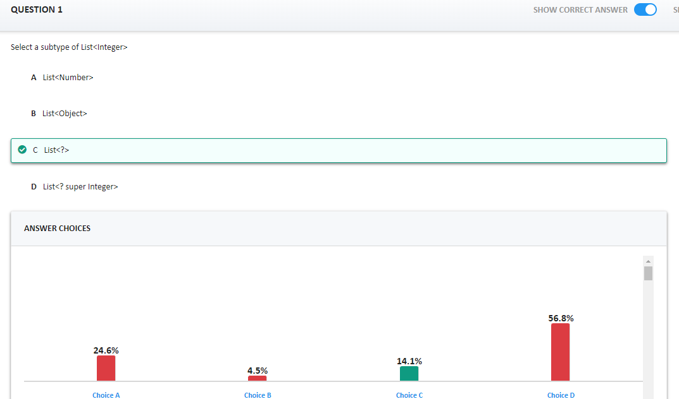
List<?> is a supertype, all others are unrelated
You should have appealed that question

Slide 5
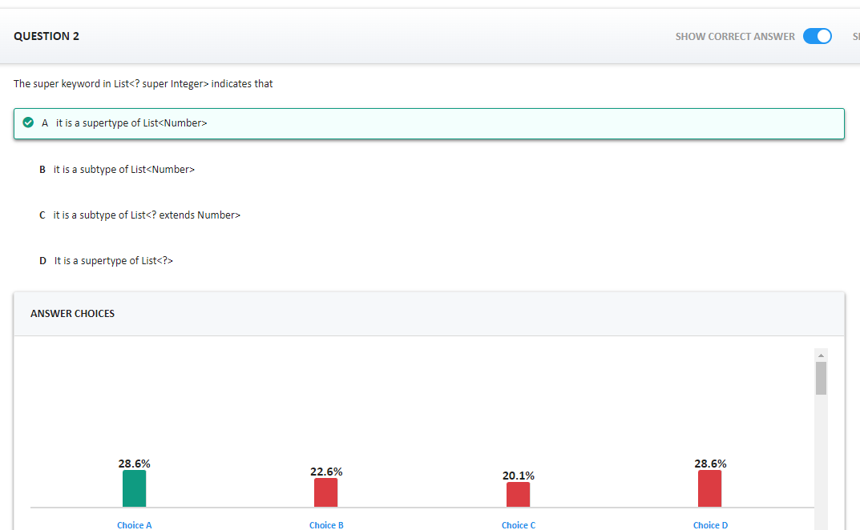
List<? super Integer> is a supertype of <List ? super Number> and of List<Number>
A is right

Slide 6
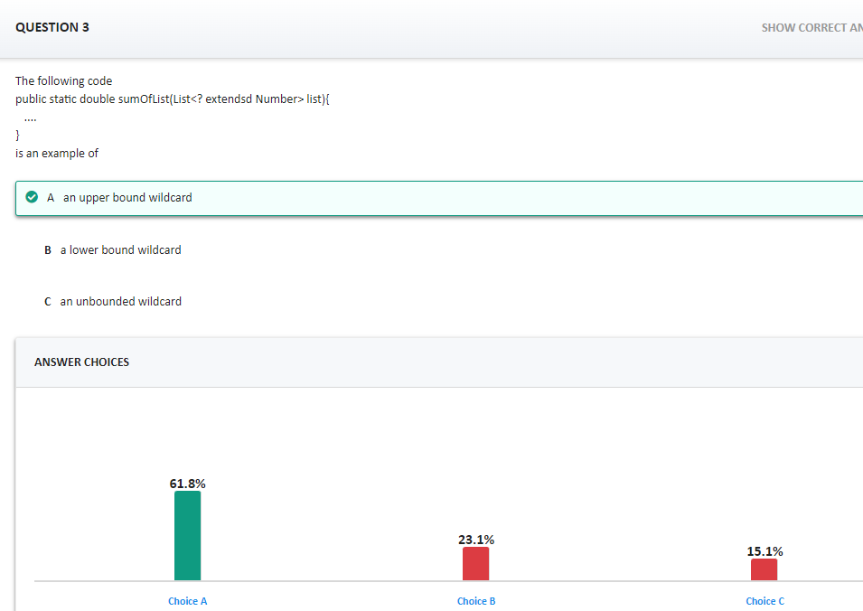
Upper bounded wildcard use the keyword extends while lower bounded wildcards use the keyword super

Slide 7
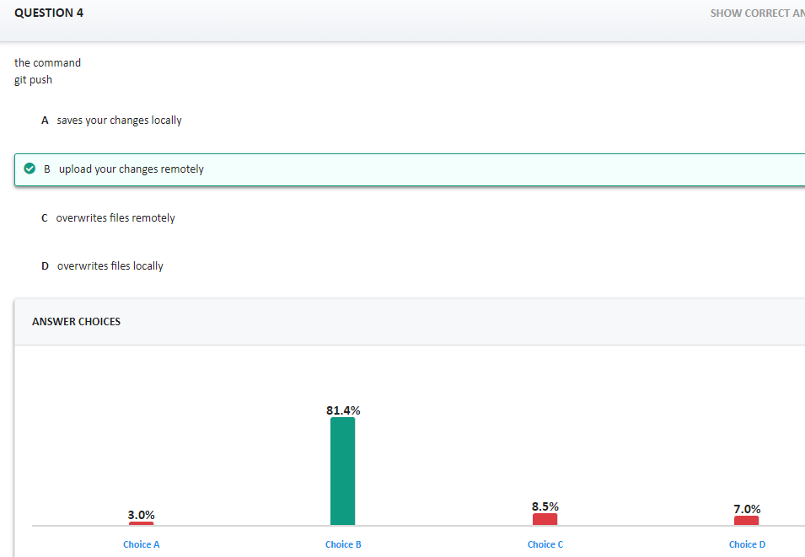
In a versioning system, you never overwrite, you create a new version. You can always go back in history to read older versions

Slide 8
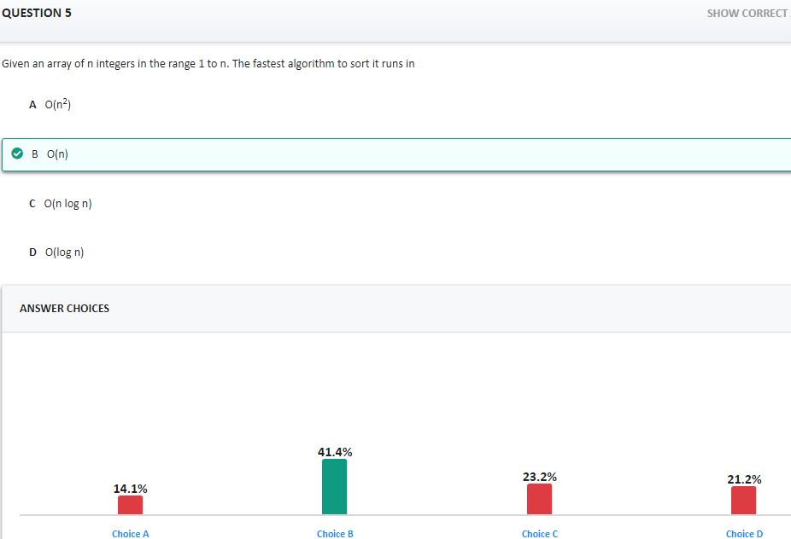
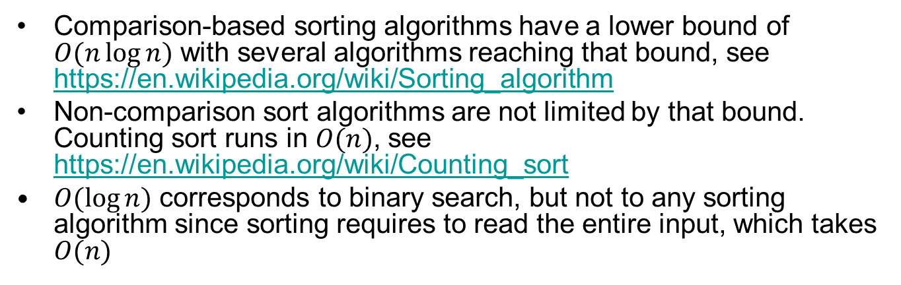
Comparison-based sorting algorithms have a lower bound of $O(n\log{n)}$ with several algorithms reaching that bound, see https://en.wikipedia.org/wiki/Sorting_algorithm
Non-comparison sort algorithms are not limited by that bound. Counting sort runs in $O(n)$, see https://en.wikipedia.org/wiki/Counting_sort
$O(\log{n)}$ corresponds to binary search, but not to any sorting algorithm since sorting requires to read the entire input, which takes $O(n)$

Slide 9
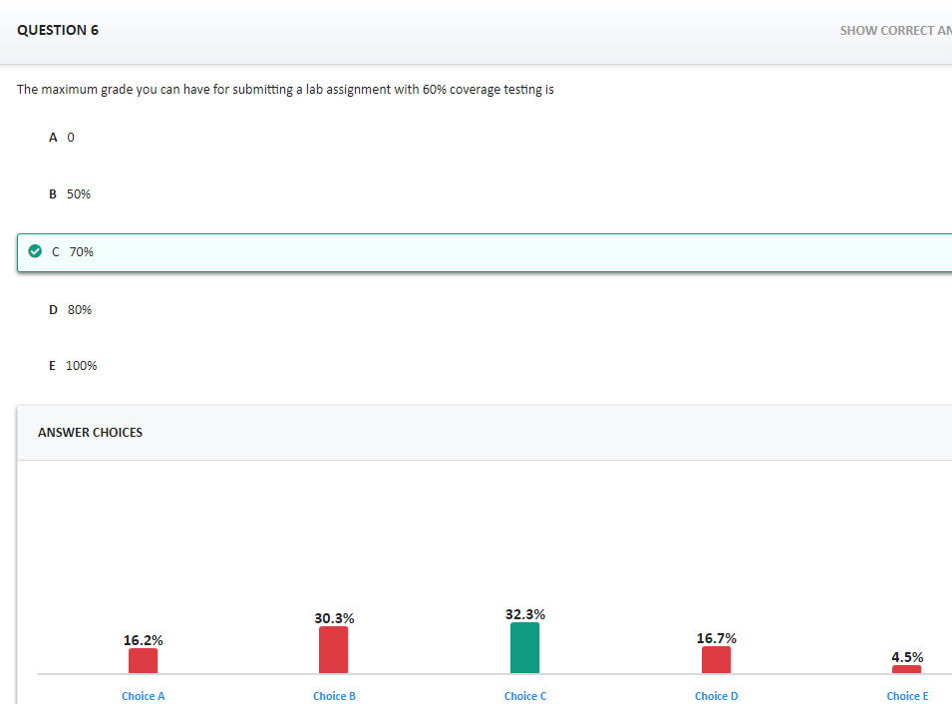
Expectations/Marking
Code does not compile = mark of ZERO
No unit test = no more than 50%
One or more unit test fail = no more than 60%
Coverage testing less than 80% = no more than 70% [Grace period of 1 lab]

Slide 10
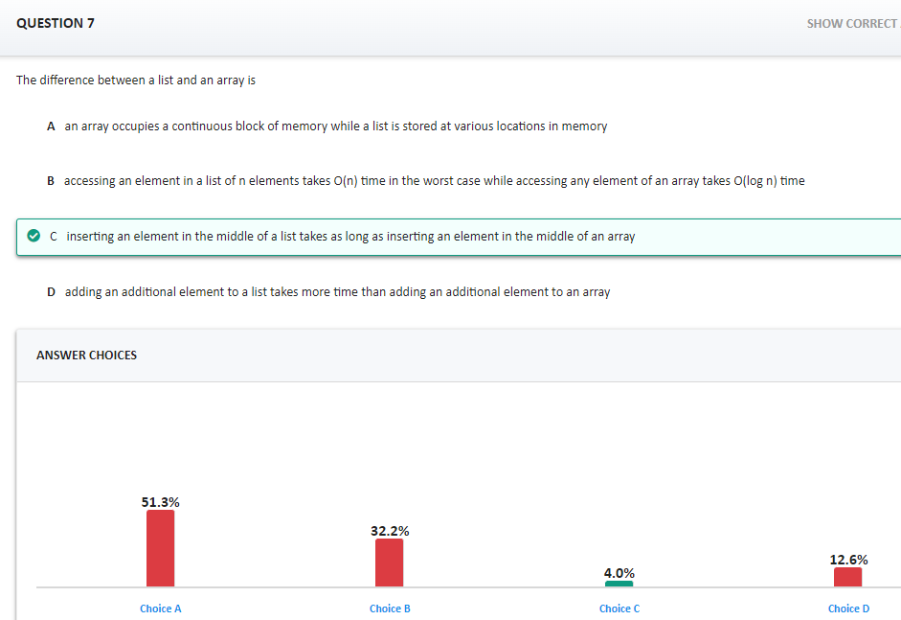
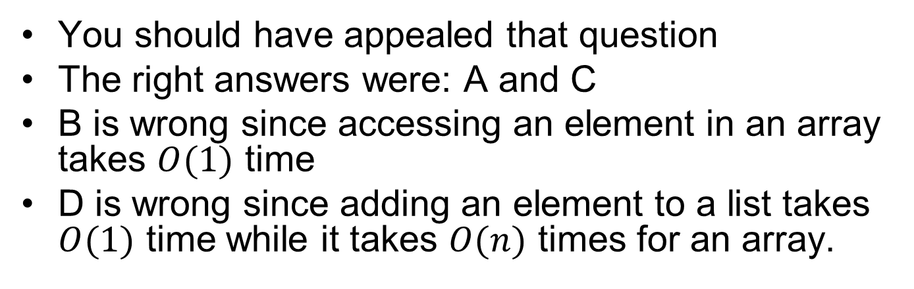
You should have appealed that question
The right answers were: A and C
B is wrong since accessing an element in an array takes $O(1)$ time
D is wrong since adding an element to a list takes $O(1)$ time while it takes $O(n)$ times for an array.

Slide 11
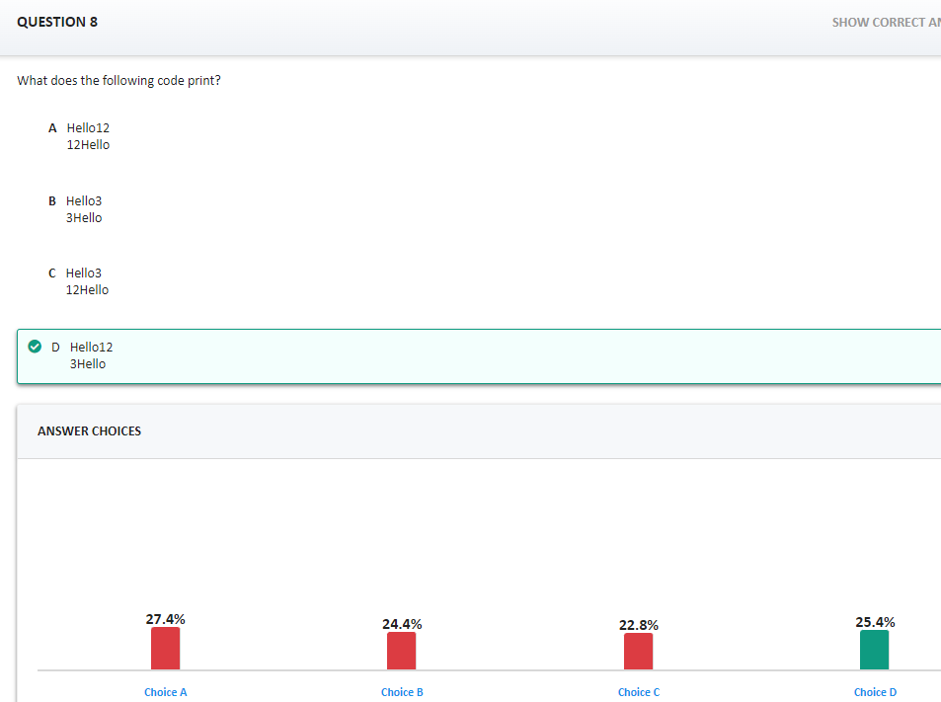
The code was missing so you should have appealed the question to get full marks.

Slide 12
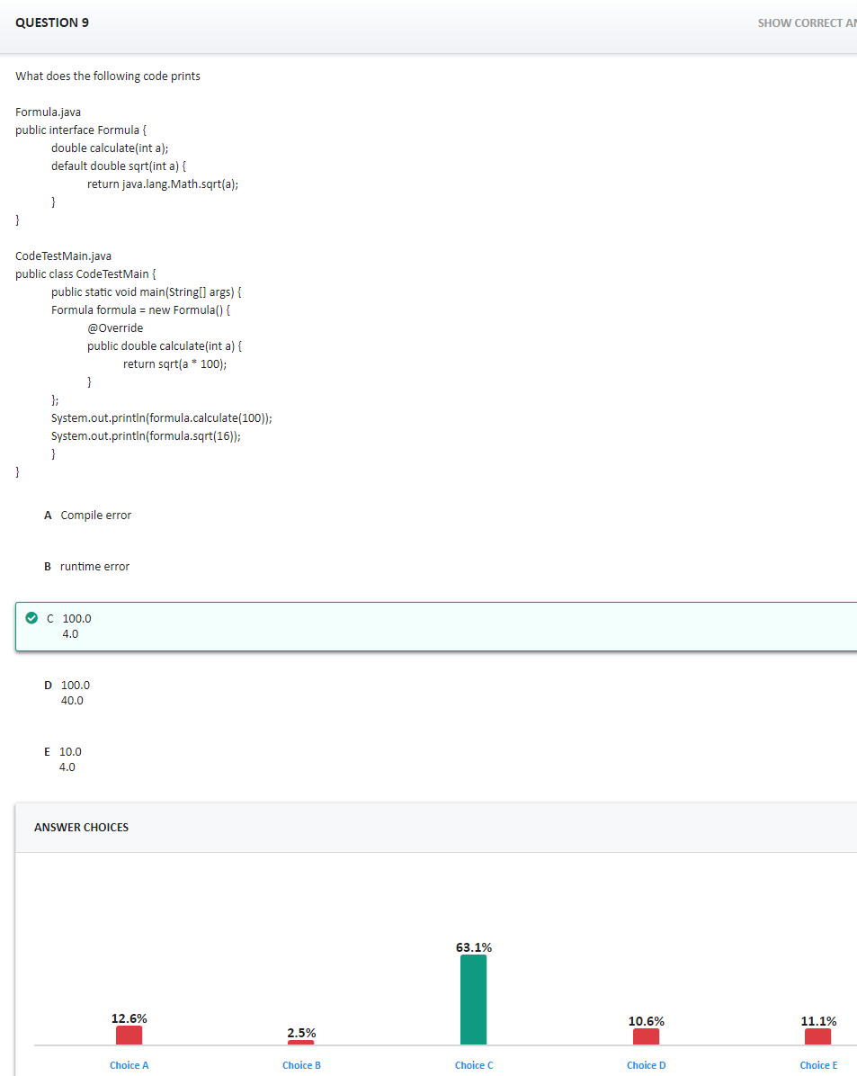
Formula.calculate(100) calls the method in the class
formula.sqrt(16) calls the method in the interface
Do not hesitate to create Java project in Eclipse and to run the code. Running the code with the debugger will show you which line is executed when.

Slide 13
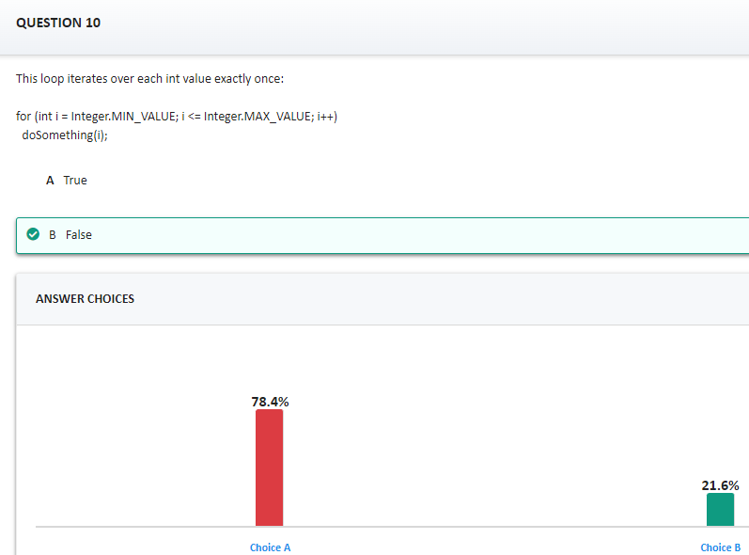
When integer.MAX_VALUE + 1 does not trigger an overflow. Java does the computation, cannot store the highest value bit, so it wraps to integer.MIN_VALUE, and the code loops indefinitely. This is by design (testing for overflow after each addition was found too time consuming).

Slide 14
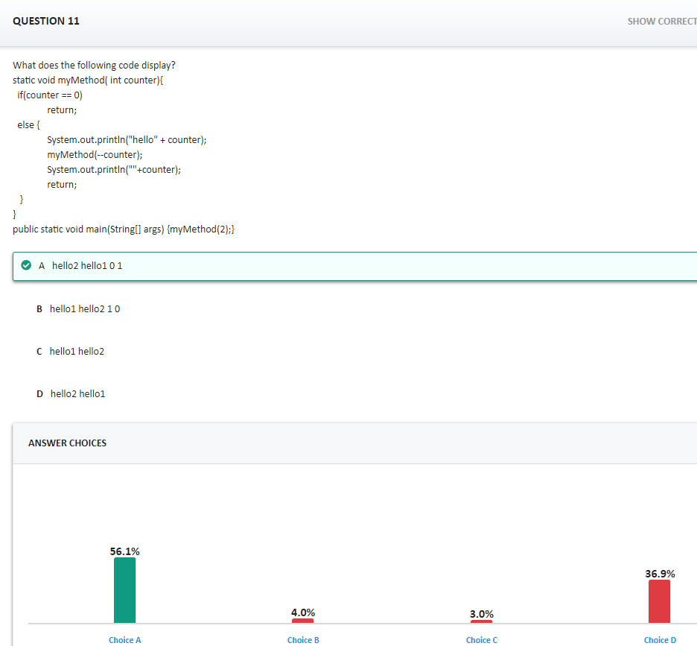
This is an example of a recursive code; use the debugger to follow the code
myMethod(2)
Prints hello2
Calls myMethod(1)
Prints hello1
Calls myMethod(0)
Return
Prints 0 and returns
Print 1 and return

Slide 15
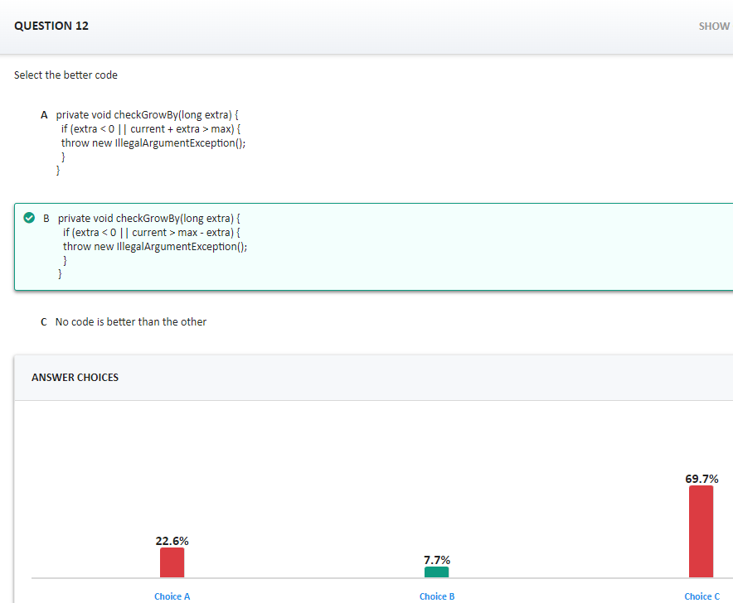
Both codes are similar except when current + extra overflow. In that case
current > max – extra performs the right test
current + extra > max overflows and always return false

Slide 16
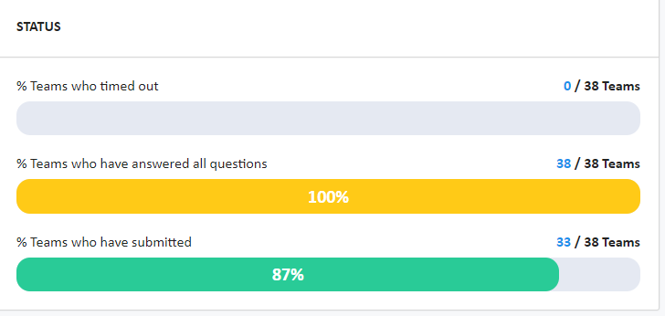
tRAT
Don’t forget to submit

Slide 17
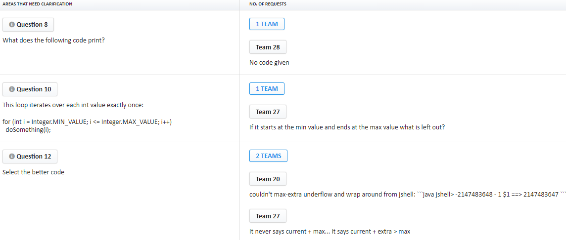
Do not hesitate to appeal questions when your entire team disagrees with the answer
You should have appealed questions: 1, 7, 8
Only Team 28 gets marks for Question 8. Other teams did not appeal, or did not give a reasonable argument.

